Slide 1
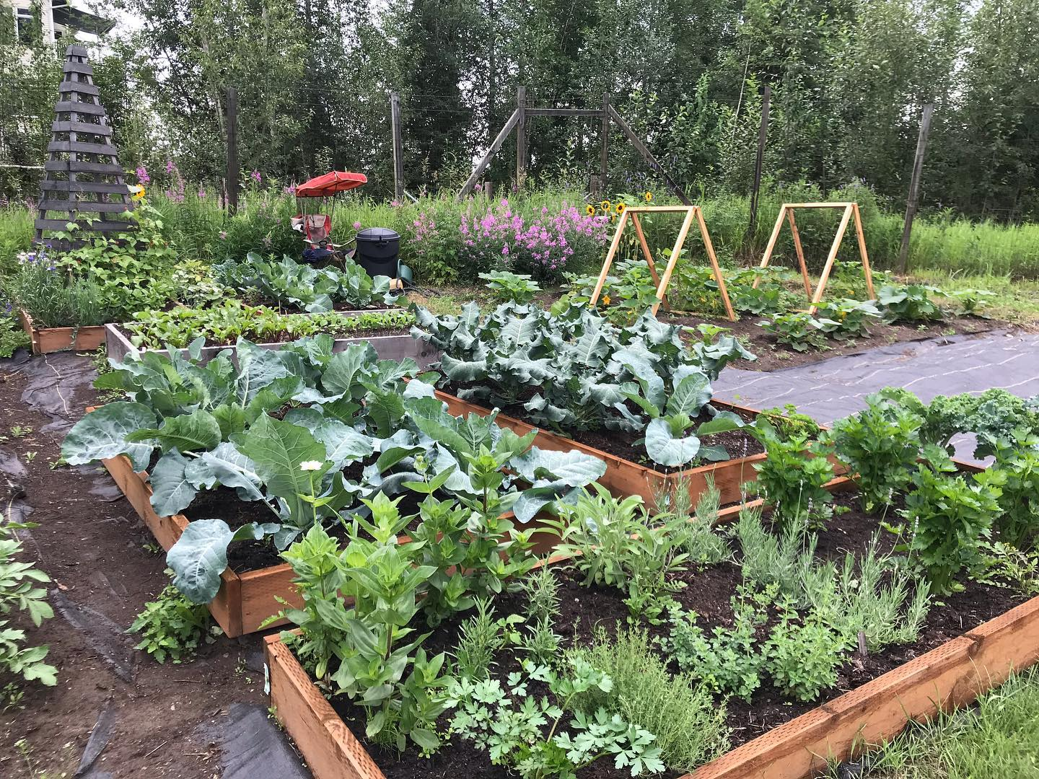
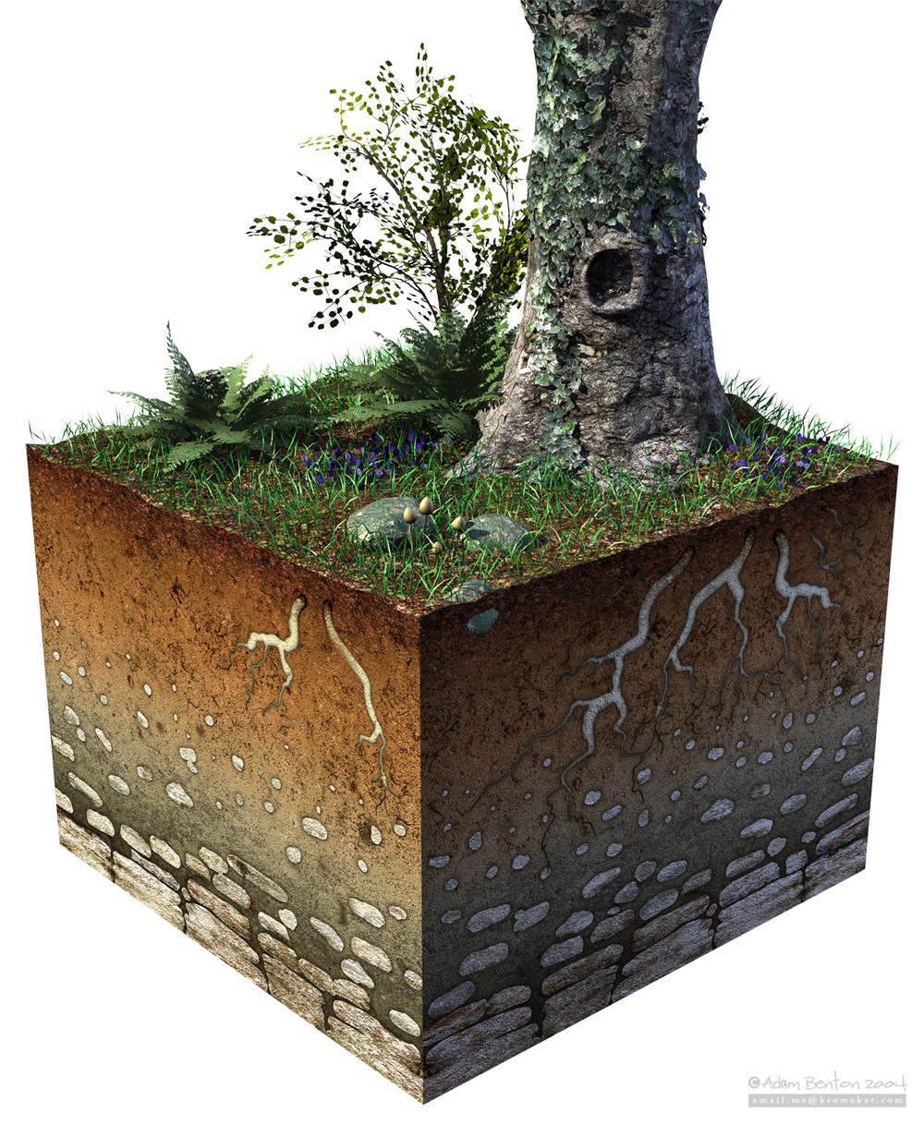
Soil Texture and Agriculture

Slide 2
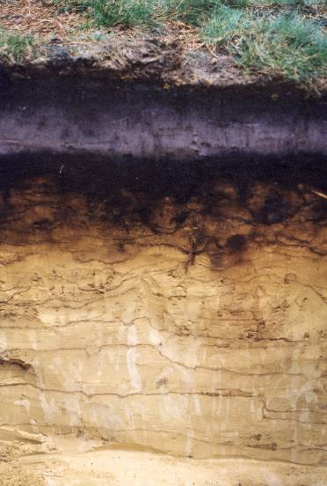
Soil Particles
Most soils have a combination of soil particles sizes
Sand
Silt
Clay

Slide 3
Particle Sizes
Clay: less than 0.002 mm
Silt: 0.002-0.005 mm
Sand: 0.05-2 mm
0.05-0.24 mm fine
0.25-0.49 mm medium
0.5-0.99 mm coarse
1- 2 mm very coarse
Gravels: 2-75 mm
Cobbles:75-250 mm
Stones: 250-600 mm
Boulders: >600 mm

Slide 4
Sand
Gritty feel
Can be seen with the naked eye
Hand sampling:
No residue left on hand

Slide 5
Silt
Dry: Powdery smooth feel, flour-like
Wet: Creamy slick, slippery feel
No sticky or plastic feel
Can be seen with a hand lens or microscope
Hand sampling:
Coats hand, able to brush off

Slide 6
Clay
Dry: Hard feel
Wet: Sticky, plastic feel
Can be seen with an electron microscope
Hand Sampling:
Sticks to fingers

Slide 7
Influences of Soil Properties
Parent Material:
Rock or original source of soil particles
Effects soil quality
Glacial outwash sands tend to be infertile, or hold few minerals and nutrients important for growth
Soils derived from other sources may be relatively rich in minerals and nutrients
Usually a combination of weathered parent materials and organic matter make a soil

Slide 8
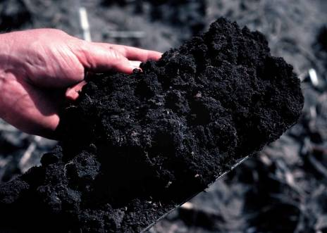
Influences of Soil Properties
Organic Matter is derived from decomposing plant and animal remains
Humus is the dark, moist layer found on the top of a soil profile. This is because it is made up of dead and decaying matter. It is fairly fertile in that the decay process adds nutrients to the soil that plants love to soak up

Slide 9
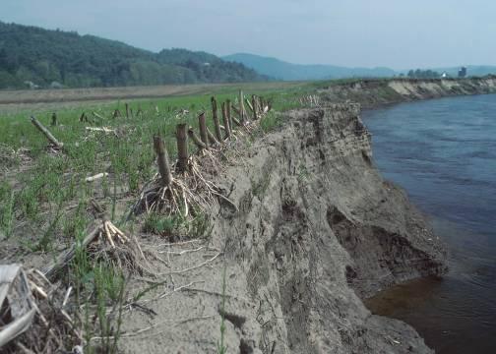
Sources of Parent Material
Weathering or erosive actions:
heating/cooling
freezing/thawing
glaciers
water
wind
chemistry
plants & animals

Slide 10
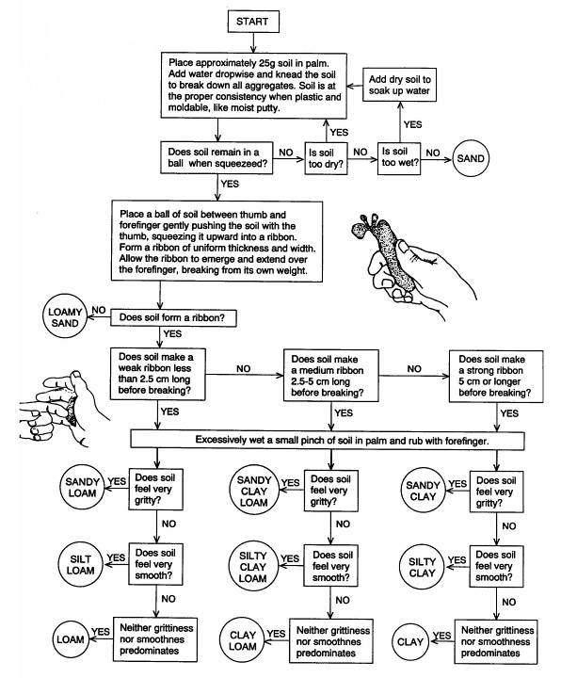
Texture by Feel

Slide 11
Soil Texture and Surface Area
As particle size decreases, surface area increases
Clay has about 10,000 times as much surface area as sand
Surface area has a big effect on:
Water holding capacity
Chemical reactions
Soil cohesion
Ability to support microorganisms

Slide 12
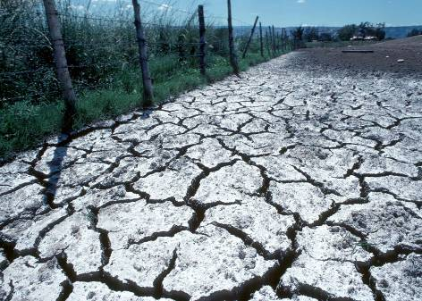
Properties Related to Texture
Porosity
Permeability
Infiltration
Shrink-swell
Water holding Capacity
Erodibility

Slide 13
Fine Textured Soil
Large amounts of silt and clay, making it "muddy" when wet
Pore spaces are small, but numerous and hold more water
As clay soils begin to dry, they may still hold large quantities of water, but adhesive and cohesive properties of water make it unavailable for root uptake

Slide 14
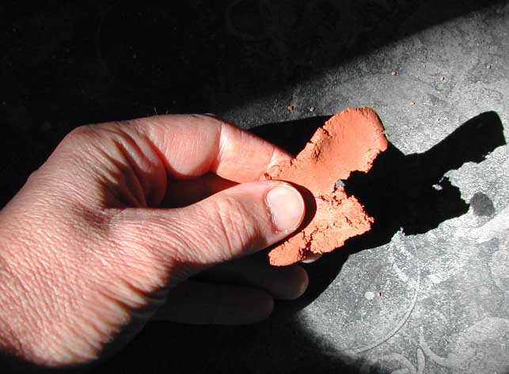
Fine Textured Soil

Slide 15
Coarse Textured Soil
Large pore spaces and allows water to easily run through it beyond the reach of roots
Drought-prone
Little surface area for the particle volume, reducing fertility

Slide 16
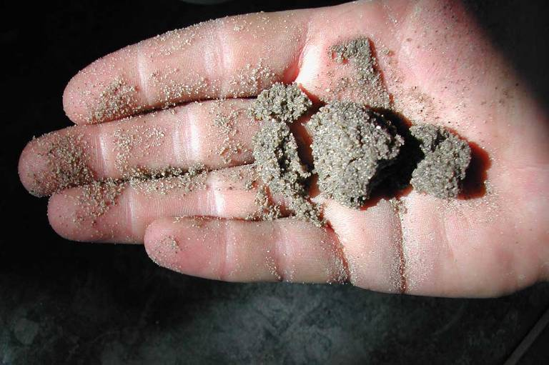
Coarse Textured Soil

Slide 17
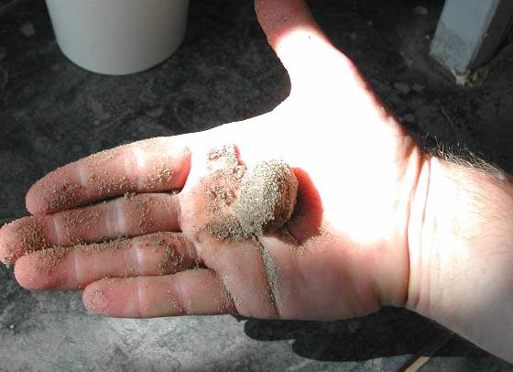
Loamy Soil
A mix of sand, silt, and clay that optimizes agricultural productivity

Slide 18
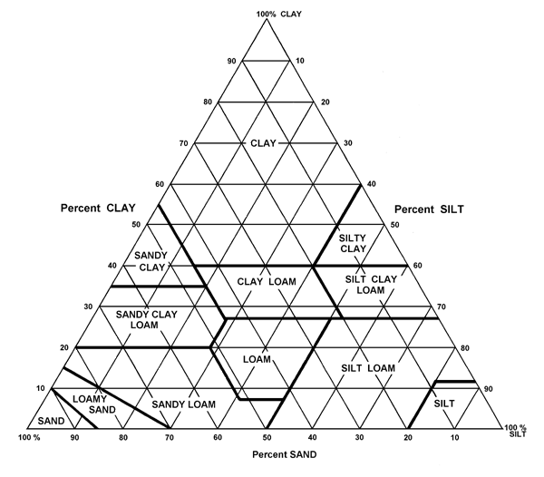
Sand + Silt + Clay = 100%
34 % Sand
Texture =
CLAY LOAM
33 % Silt
33 % Clay
Notes:
Please explain how to use the textural triangle. I usually give an example of 20% silt and 20% clay. What is the textural class?
Please explain that the majority of the textural triangle is made up of classes that have the term clay in them even though these soils may have little more than 20% clay. This is because of the specific properties of the clay fraction. Please mention surface area and charge characteristics.

